Slide 1
Cryptography
Hash Function
CSC 481/681/781
Principles of Computer Security

Slide 2
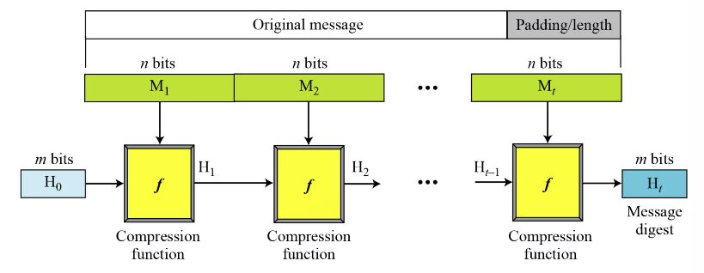
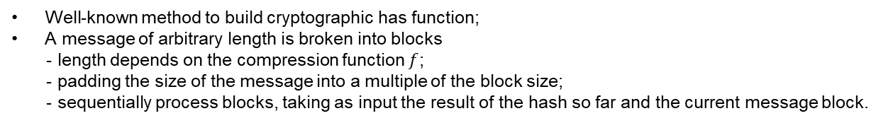
Hash Functions Family
Merkle-Damgard Scheme
Well-known method to build cryptographic has function;
A message of arbitrary length is broken into blocks
- length depends on the compression function $f$;
- padding the size of the message into a multiple of the block size;
- sequentially process blocks, taking as input the result of the hash so far and the current message block.

Slide 3
Hash Functions Family
MD(Message Digest) - Designed by Ron Rivest
Family: MD2, MD4, MD5
SHA(Secure Hash Algorithm) - Designed by NIST
Family: SHA-0, SHA-1, and SHA-2
SHA-2: SHA-224, SHA-256, SHA-384, SHA-512
SHA-3: New standard in competition
RIPEMD(Race Integrity Primitive Evaluation Message Digest) - Developed by Katholieke University Leuven Team
Family: RIPEMD-128, RIPEMD-160, RIPEMD-256, RIPEMD-320

Slide 4
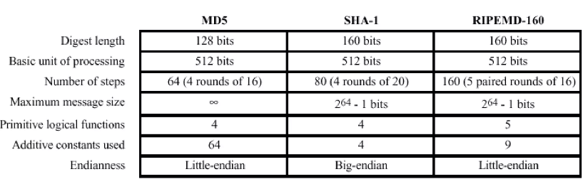
Hash Functions Family

Slide 5
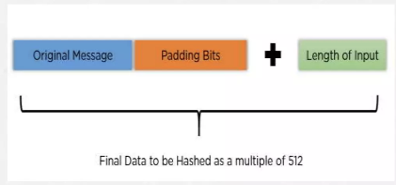
MD5
Padding
Suppose we are given a message of 1000 bits. Now we have to add padding bits to the original message. Here we will add 472 padding bits to the original message.
After adding the padding bits the size of the original message/output of the first step will be 1472, i.e. 64 bits less than an exact multiple of 512 (i.e. 512*3=1536).
Length(original message + padding bits)= 512 *I - 64 where i =1,2,3.
Add the length bit in the output of the first step in such a way that the total number of the bits is the perfect multiple of 512. Simply, here we add the 64-bit as a length bit in the output of the first step.

Slide 6
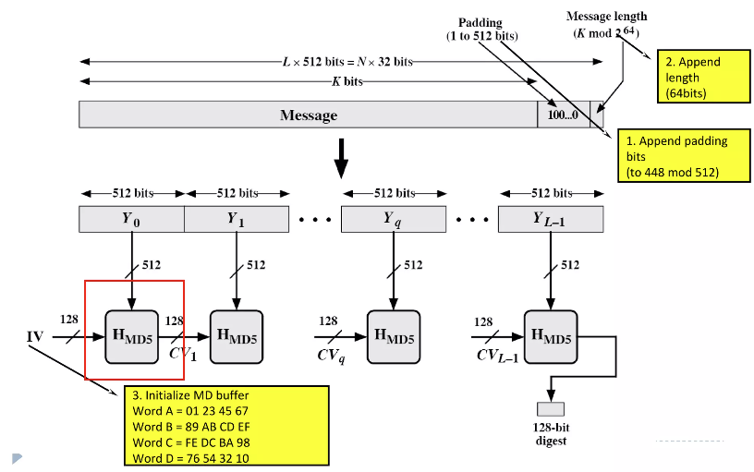
MD5
Overview

Slide 7
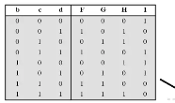
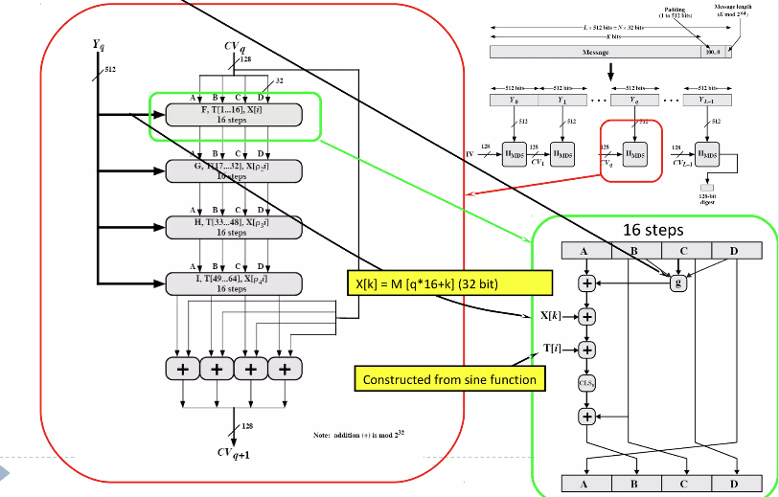
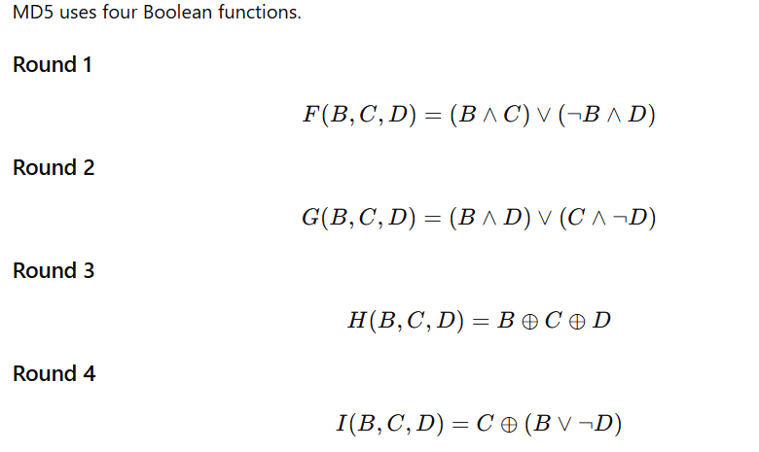

MD5
Within each $H_{MD5}$
4 round
512/32=16 steps

Slide 8
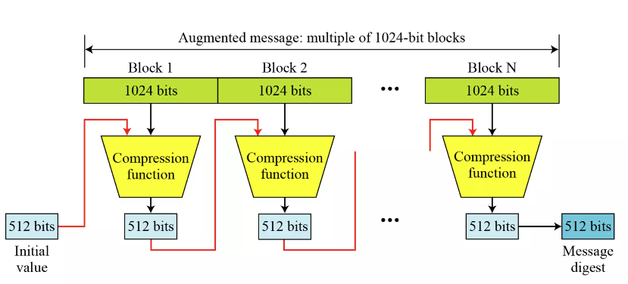
SHA-512
Overview

Slide 9
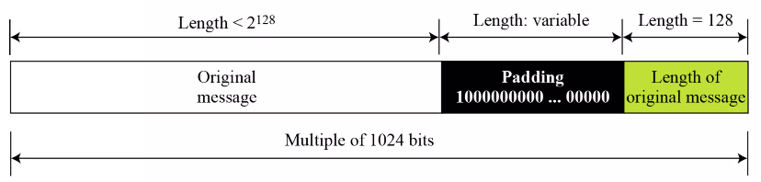
SHA-512
Padding
What is the number of padding bits if the length of the original message is 2590 bits?

Slide 10
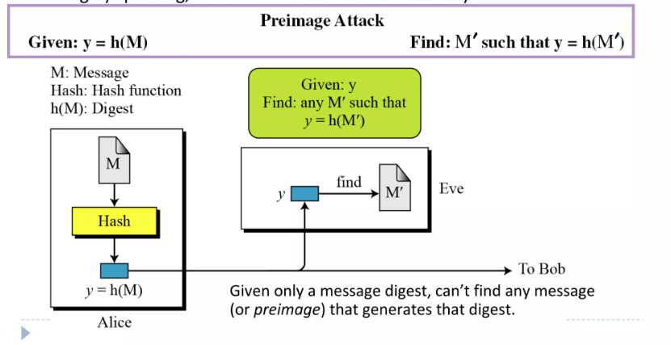
Brute-Force Attacks
Preimage attack: Given a hash value $y$, try all possible inputs $M′$ until one matches.

Slide 11

Brute-Force Attacks
Precomputation Attack: Compute a table of (password → hash) pairs in advance. lookup time $≈O(1)$.
Enormous storage cost (impractical for large password spaces)

Slide 12
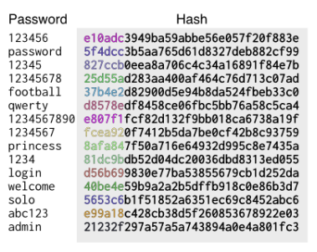

Brute-Force Attacks
Rainbow Table Attack : improves on earlier precomputed hash tables by using a clever time–memory trade-off based on chained hash-reduction operations.
Key Idea: Hash–Reduction Chains
A reduction function R() converts a hash value back into a new password-like string (not the original password — just something in the same password space).
Only ‘aaaaaa’ and ‘kiebgt’ are stored.
Given a hash value 920ECF10, we have
The password of 920ECF10 is "sgfnyd“.
https://en.wikipedia.org/wiki/Rainbow_table

Slide 13
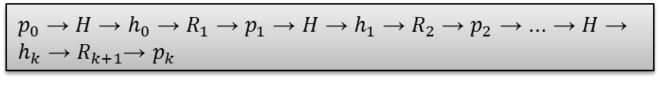
Brute-Force Attacks
Rainbow Table Attack : improves on earlier precomputed hash tables by using a clever time–memory trade-off based on chained hash-reduction operations.
Key Idea: Hash–Reduction Chains
Why “Rainbow”?
If you use one reduction function R() for every step, chains often merge and waste space, because independent chains might collide.
$p_{0}$ → $H$ → $h_{0}$ → $R_{1}$ → $p_{1}$ → $H$ → $h_{1}$ → $R_{2}$ → $p_{2}$ → ... → $H$ → $h_{k}$ → $R_{k+1}$→ $p_{k}$
https://en.wikipedia.org/wiki/Rainbow_table

Slide 14
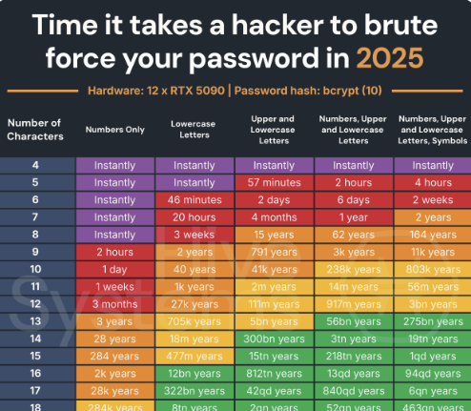
Brute-Force Attacks
https://www.hivesystems.com/blog/are-your-passwords-in-the-green

Slide 15
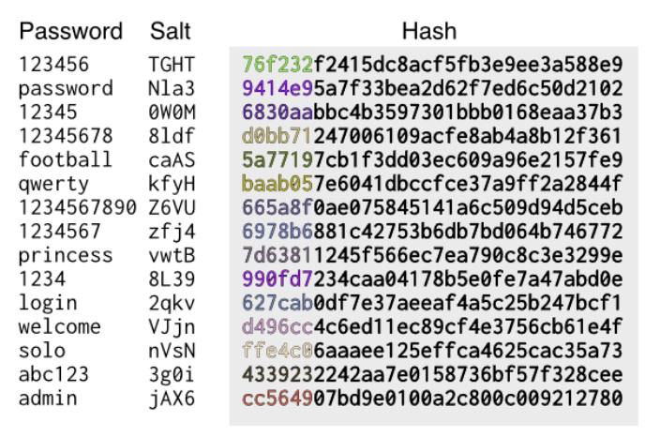
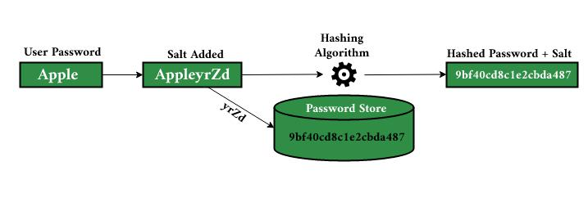

Brute-Force Attacks
How to defense Rainbow Table Attack?
Need to compute $2^{32}$ rainbow table for 32 bits salt

